Slide 1
ReAgent:
Point Cloud Registration using Imitation and Reinforcement Learning
Dominik bauer, Timothy Patten and Markus Vincze
TU Wien
Vienna, Austria
Presenter : 김진용

Slide 2
Content
Background
Point Cloud Registration
RL, IL
Define Problem
Point Cloud Registration Agent
Reagent Architecture
Imitation an Expert Policy
Improving through Reinforcement
Experiment

Slide 3
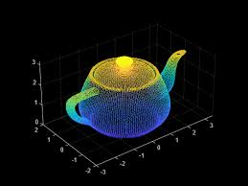
Background
What is Point Cloud?
(X, Y, Z) n x 3 set
If number of point cloud is n,
it has below structure.
[[X1, Y1, Z1],
[X2, Y3, Z2],
…
[Xn, Yn, Zn]]
Point Cloud

Slide 4
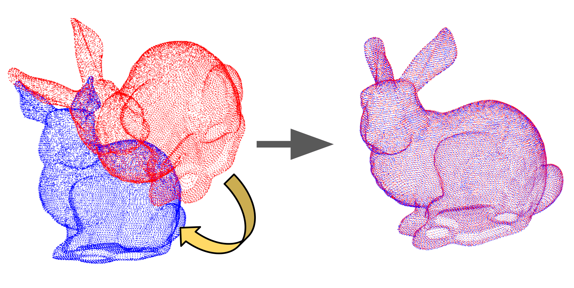
Background
What is Point Cloud Registration?
Source Point Cloud
Target Point Cloud
Registration

Slide 5


Background
What is Reinforcement Learning and Imitation Learning?
Reinforcement Learning
Imitation Learning
Action
Action
Environment
Environment
Imitation
Reward
State
State

Slide 6
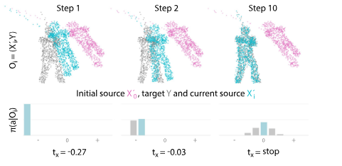
Define Problem
Classical Registration Methods generalize well to novel domains but fail when given a noisy observation or a bad initialization.
Learning-based methods, in contrast, are more robust but lack in generalization capacity.
RL + IL
Iterative
Point Cloud Registration

Slide 7
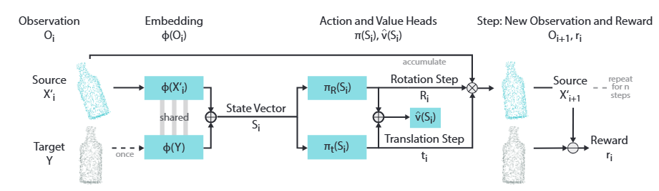
Point Cloud Registration Agent
Reagent Architecture
Action vector
From state vector, actor-critic predicts rotation and translation action vector.
Step
We transform previous observation to new observation by using transformation matrix. And environment offers reward comparing chamfer distance between two observations.
State Vector
The number of point cloud is 1024.
We have to extract feature to reduce computational cost.
We may use MLP to get state vector S_i.

Slide 8
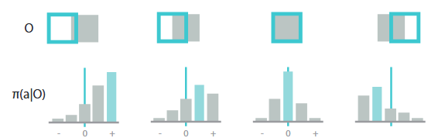
Point Cloud Registration Agent
Discrete action space
Translation : cartesian
Rotation : radian
x,y,z,no_ops : 33 dim
P(a|s)
-0.27 -0.09 -0.03 -0.01 -0.0033 0 0.0033 0.01 0.03 0.09 0.27
Large step to right
Small step to right
No operation
Small step to left

Slide 9
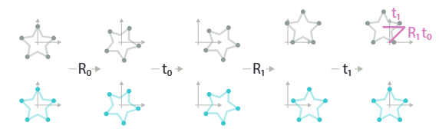




Point Cloud Registration Agent
Disentangled transformation
Global Transformation
The center point of rotation matrix is global origin coordinate. It entangles rotation and translation matrices. It is hard to know global translation whether it is lead by rotation matrix or translation matrix.
Disentangled Transformation
We may use rotation matrix by object center point. It improves interpretability how model acts by using object’s local rotation.
It means that translation and rotation matrices are separated.

Slide 10








Imitating an Expert Policy
Expert policy
State1
State2
State3
State10

Slide 11
Imitating an Expert Policy
Data gathering
P(a|s)
-0.27 -0.09 -0.03 -0.01 -0.0033 0 0.0033 0.01 0.03 0.09 0.27
If expert data of translation x is 0.3, since maximum size of expert policy is 0.27, 0.27 is chosen as gt.
If expert data of translation x is 0.0001, 0 is chosen as gt.
If expert data of translation x is -0.09, -0.09 is chosen as gt.

Slide 12
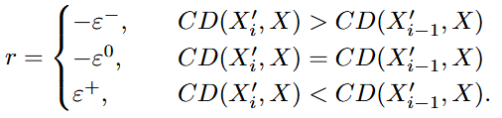

Improving through Reinforcement
Reward function

Slide 13

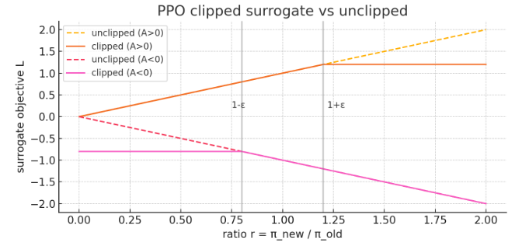
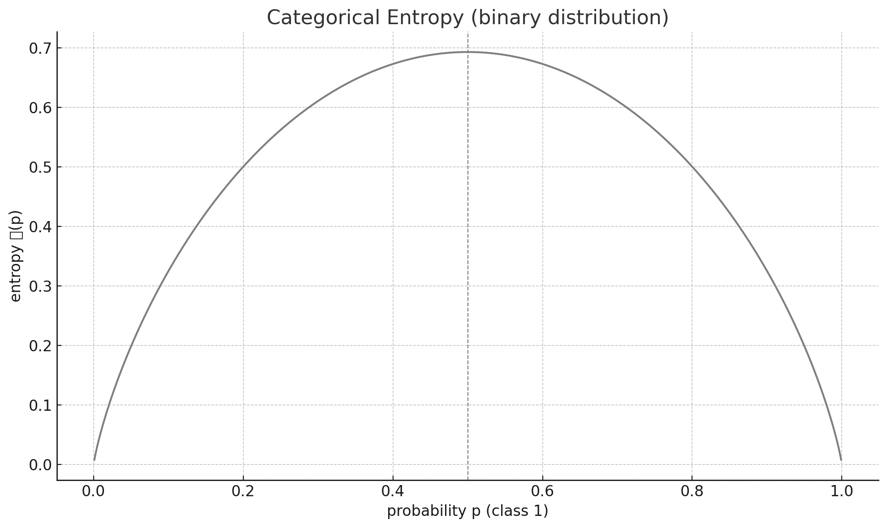
Improving through Reinforcement
PPO
Policy Gradient : If the action is good behavior, log probability of action is encouraged.
Value loss : High advantage means that value function doesn’t predict value well. It is encouraged to reduce advantage to predict value precisely.
Entropy loss : Low probability is encouraged to be increased and High probability is encouraged to be reduced. Exploration is maximize.
PPO Clip
If action is good and ratio is over 1+E, surrogate objective is limited not to be increased for training stability.
If action is good and ratio is under 1-E, loss is encouraged to be increased.

Slide 14
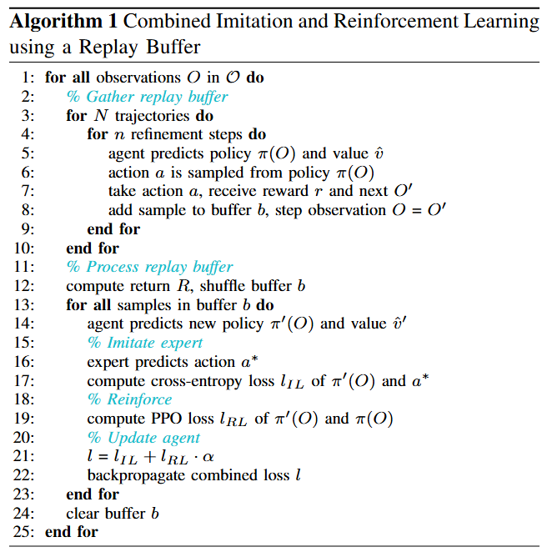
Improving through Reinforcement

Slide 15
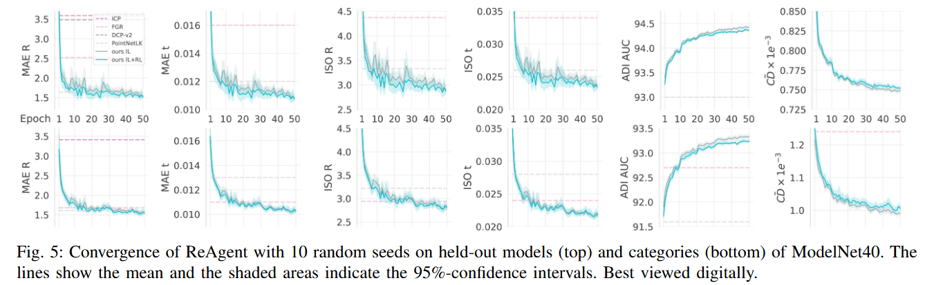
Experiment

Slide 16
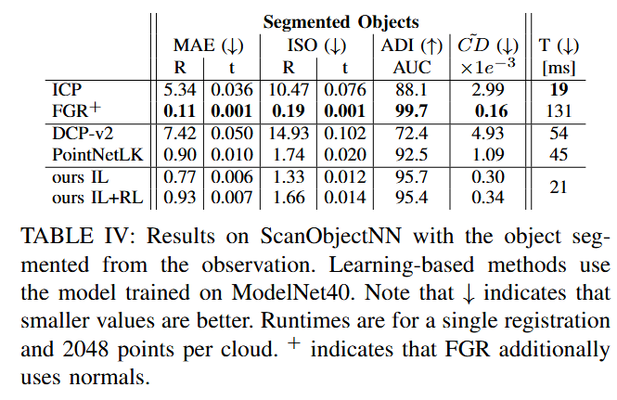
Experiment

Slide 17
Thank you

